Slide 1
1-1 Patterns and
Inductive Reasoning

Slide 2
What do you know?
Pretest

Slide 3
Inductive Reasoning is based on patterns we observe.
Find the pattern and the next two terms in each sequence:
5, 10, 15, 20, _____, _____

Slide 4


You try these:
2, 4, 8, 16, ____, ____
4, 44, 444, 4444, ______, ______
1, -2, 3, -4, ____, ____
100, 50, 25, 12.5, ____, ____
O, T, T, F, F, S, S, ____, ____

Slide 5
A conjecture is a conclusion reached by inductive reasoning.
Let’s make a conjecture about the sum of the first 30 odd numbers.
1
1+3
1+3+5
1+3+5+7
1+3+5+7+9
The sum of the first 30 odd numbers is ______.
The sum of the first n odd numbers is ______.

Slide 6
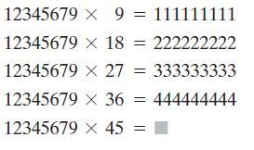
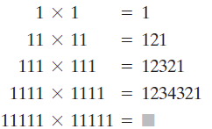
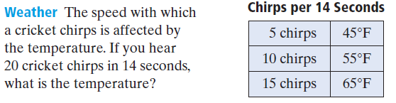
Conjecture Examples

Slide 7
A counterexample is an example for which the conjecture is incorrect.
Give a counterexample to the statements:
“All numbers are positive.”
“All animals have four legs”

Slide 8
Find a counterexample:
The sum of two numbers is greater than either number.
The product of two positive numbers is greater than either number.

Slide 9
Exit Slip
Homework

