Slide 1
1-5 Bisectors

Slide 2
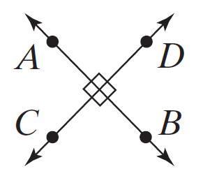
Perpendicular Lines are two lines that meet at a right angle.
We write

Slide 3
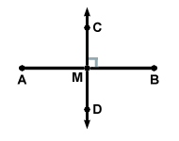
A perpendicular bisector is a perpendicular line or segment that divides another segment into two congruent segments.

Slide 4
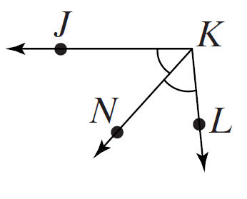
An angle bisector is a segment through the vertex of an angle that divides the interior of the angle into two congruent parts.

Slide 5
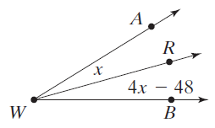
Example 1

Slide 6
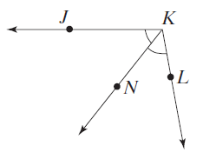
Example 2

Slide 7
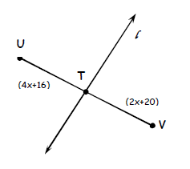
Example 3
Line l is the perpendicular bisector of segment UV. Find the length of UT and UV.

