Slide 1
Algebra 1 Common Assessment 2 Review
With Video Solutions

Slide 2
Common Assessment FAQs
What will the exam cover?
Everything from this semester (Topics 1-4) . There are 20 questions. The topics can be found here.
Do I have to take the test?
Yes. The test is required for all Algebra 1 students and in FCPS and will be entered into IC as a test grade.
Can I use a calculator on the test?
Yes. Use the DESMOS calculator linked here. (scientific or graphing as needed). Or click on the green DESMOS icon to access a calculator.
How can I prepare for the test?
I suggest working through the review given to you by your teacher. These questions model the type of questions you will see on the test. If you need extra help, check the following slides on this document for more of the same type of problems but with video explanations.

Slide 3
Question 1
Answer

Slide 4
Question 2
Answer

Slide 5
Question 3
Answer

Slide 6
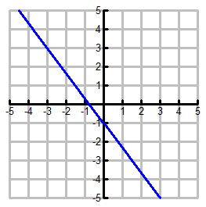
Question 4
Answer
Write the equation of the line in slope intercept form.

Slide 7
Question 5
Answer
Write the equation of the line that passes through (6, -5) and (9, -11) in slope-intercept form.

Slide 8
Question 6
Answer
Find the equation for a line with an x-intercept of 2 and a y-intercept of 5.

Slide 9
Question 7
Answer

Slide 10
Question 8
Answer
Identify the domain and range of the relation
X Y

Slide 11
Question 9
Answer
Which of the following are arithmetic sequences? Select All that Apply.
0, 1, 3, 6, 10, …
12, 9, 6, 3, 0, …
-7, -3, 1, 5, 9, …
32, 16, 8, 4, 2, …

Slide 12
Question 10
Answer
What is the solution of the system of equations?

Slide 13
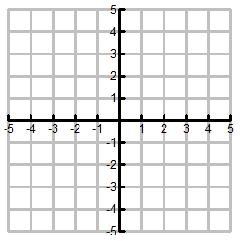
Question 11
Answer

Slide 14
Question 12
Answer
Is the following relation a function? Explain.
{(1, 3), (4, -6), (-2, 7), (-1, 7), (-2, 5)}

Slide 15
Question 13
Answer
Molly is starting a babysitting business. She decides to charge her clients $12 per hour plus a fee for hiring her. Look at the table. Write the linear function f Molly can use to determine her pay.

Slide 16
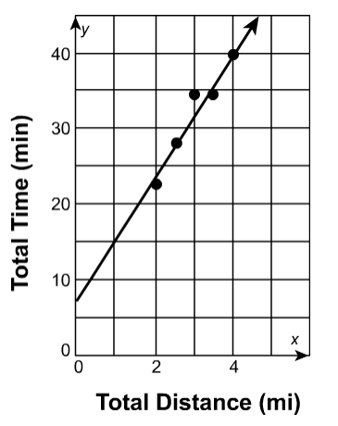
Question 14
Answer
Estimate the trend line (line of best fit) for the graph shown below.

Slide 17
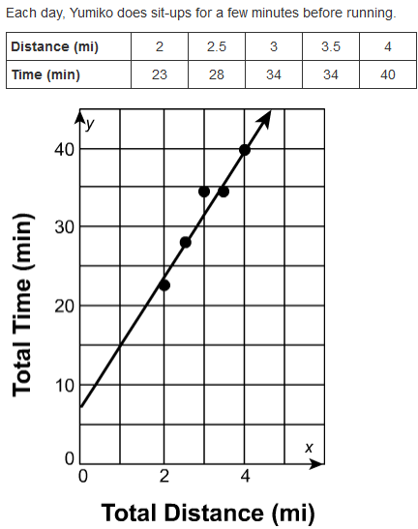
Question 15
Answer

Slide 18
Solve the system by graphing. Write the solution as an ordered pair.
Question 16
Answer

Slide 19
Determine if the following system has no solution, one solution, or infinitely many solutions.
4x - 2y = -22
y = 2x + 11
Question 17
Answer

Slide 20
Question 18
Find the solution to the system of equations. Write the solution as an ordered pair.
5x + 7y = -13
2x + 3y = -7
Answer

Slide 21
Question 19
Answer
At a clothing store, 3 shirts and 6 hats cost $126. The cost of 2 shirts and 2 hats is $52. How much does one hat cost?

Slide 22
Question 20
Answer
Graph the system of inequalities.
x + y > -1
x - 3y ≥ -9

